Slide 1



Sales insights
View in Power BI
Last data refresh:
5/24/2022 12:26:12 PM UTC
Downloaded at:
5/24/2022 12:27:07 PM UTC

Slide 2
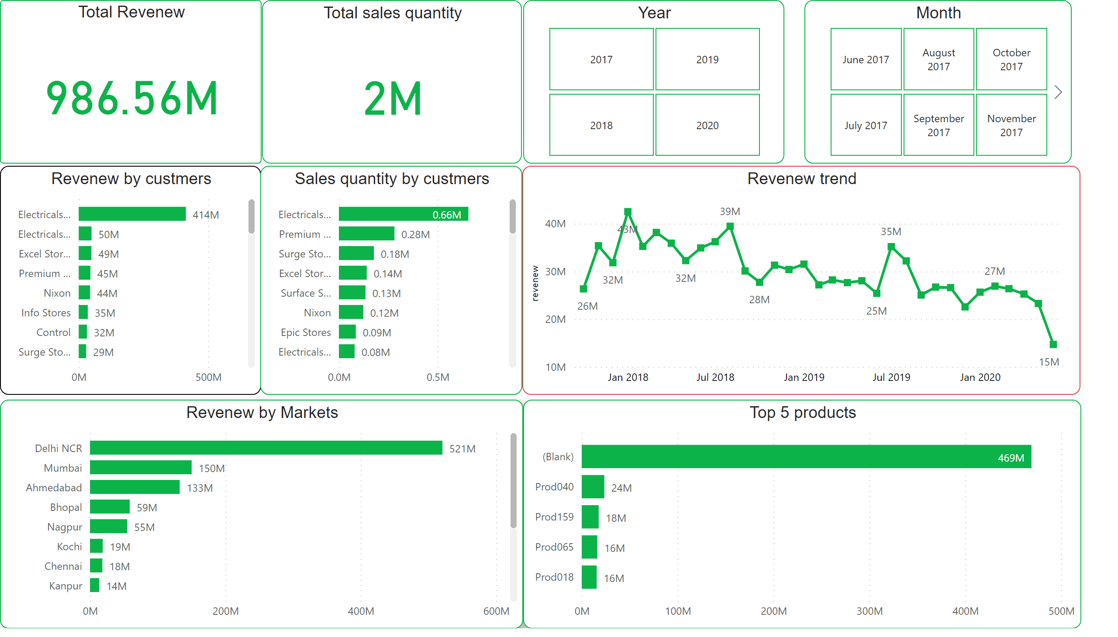
Page 1
Notes:
Total Revenew
No alt text provided
Total sales quantity
No alt text provided
Revenew by custmers
No alt text provided
Sales quantity by custmers
No alt text provided
Month
No alt text provided
Year
No alt text provided
Revenew by Markets
No alt text provided
Top 5 products
No alt text provided
Revenew trend
No alt text provided

